Slide 1

“SRU IDEA CONCLAVE 2025 ” Organized by School of Computer Science & Artificial Intelligence, SR University, Warangal (Date : 20th To 21st of February 2024)
A Single-Axis Solar Tracking System for Improved Energy Efficiency
Presented by
B. Sathvika Reddy
V. Manaswini
K. Varshitha
M. Uma Sri

Slide 2
Presentation Outline
Invention Title
Problem Statement
Existing Solutions / Prior Art / Related Applications & Patents
Description of Proposed Invention
Novelty
Comparison
Additional Information

Slide 3
A Single-Axis Solar Tracking System for Improved Energy Efficiency
Introduction :
Solar energy is a sustainable and abundant renewable source, but fixed solar panels lose efficiency as the sun moves. To address this, solar tracking systems have been developed. A single-axis tracker offers a cost-effective solution by adjusting panel position to follow the sun, improving energy capture while remaining more affordable than dual-axis systems.

Slide 4
Problem Statement
Fixed solar panels lose efficiency as the sun moves, while dual-axis trackers are costly and complex. A single-axis tracker offers a cheaper alternative but often struggles with efficiency, power use, and durability. There is a need for a low-cost, energy-efficient, and durable single-axis tracking system to maximize solar energy capture affordably.

Slide 5
Existing Solutions / Prior Art / Related Applications & Patents
Fixed solar panels do not track the sun, leading to inefficiencies
Single-axis tracking systems exist but often rely on high-power motors, increasing operational costs.
3. Prior patents exist for solar tracking using stepper motors and sensors, but they often suffer from high power consumption and mechanical complexity.

Slide 6
Description of Proposed Invention
The proposed single-axis solar tracking system automatically adjusts the orientation of solar panels along the east-west direction to maximize solar energy capture. It uses:
Light-dependent resistors (LDRs) to detect sunlight intensity and determine optimal positioning.
A low-power motor (servo/stepper motor) to rotate the panel based on sensor feedback.
An energy-efficient microcontroller (e.g., Arduino, ESP32) to control the tracking mechanism.

Slide 7
Novelty
Unique Features:
Automated Sun Tracking: The system continuously adjusts the panel’s angle throughout the day to maximize sunlight absorption, unlike fixed solar panels.
Cost-Effective Design: Uses a single-axis mechanism, reducing costs compared to dual-axis trackers while still significantly improving efficiency.
Energy-Efficient Operation: The system consumes minimal power, ensuring more energy is produced than used for tracking.
Microcontroller-Based Control: Utilizes an Arduino/ESP32 for precise movement and real-time optimization.

Slide 8
5. Light-Dependent Resistor (LDR) Integration: Detects sunlight intensity for accurate tracking without requiring complex sensors. 6. Weather-Resistant & Durable: Designed with robust materials to withstand varying environmental conditions, ensuring longevity.
7. Scalability & Adaptability: Can be easily integrated into residential, commercial, and industrial solar setups, making it a versatile solution.

Slide 9
Justification: The proposed system enhances energy yield by adjusting to sunlight movement, unlike fixed panels. It balances efficiency and affordability better than costly dual-axis trackers while consuming minimal power to ensure energy gains exceed operational costs. IoT integration enables smart analytics and remote control, setting it apart from basic mechanical systems. Additionally, its durable and low-maintenance design makes it a practical and sustainable solution for various applications.

Slide 10
Comparison
Advantages:
Improved Energy Efficiency:
Increases energy output by 25-35% compared to fixed systems.
Allows solar panels to capture sunlight throughout the day.
Cost-Effectiveness:
Lower initial cost compared to dual-axis trackers.
Reduced maintenance due to simpler design.
Simplicity and Durability:
Fewer moving parts and more reliable, especially in harsh weather conditions.
Space Efficiency:
Requires less land area compared to dual-axis systems.
Scalability:
Suitable for both residential and large-scale utility installations.

Slide 11
Differences from Previous Solutions:
Fixed Solar Panels:
Energy Efficiency: Lower output due to fixed angle.
Cost: Cheaper upfront but lower energy production.
Maintenance: Minimal, but performance is suboptimal.
Dual-Axis Solar Trackers:
Energy Efficiency: Higher output (35-45% gain) but more expensive and complex.
Cost: Higher due to dual-axis mechanisms.
Maintenance: More complex and prone to failure

Slide 12
Additional Information
Components:
Solar Panel
DC Motor or Stepper Motor:
Motor Driver
Light Sensors
Microcontroller
Resistors
Power Supply
Frame Material
Cables and Connectors
Potentiometer

Slide 13
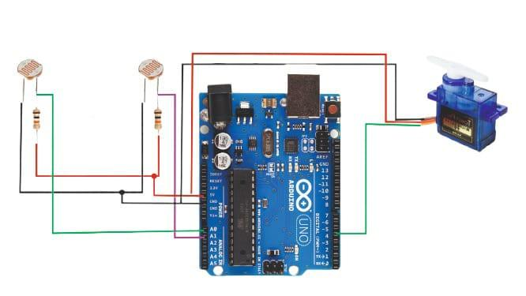
Circuit Diagram

Slide 14
Software Code
#include <Servo.h>
Servo sg90;
int initial_position = 90;
int LDR1 = A0;
int LDR2 = A1;
int error = 5;
int servopin=4;
void setup()
{
sg90.attach(servopin);
pinMode(LDR1, INPUT);
pinMode(LDR2, INPUT);
sg90.write(initial_position);
delay(2000);
}
void loop()
{
int R1 = analogRead(LDR1); // read LDR 1
int R2 = analogRead(LDR2); // read LDR 2
Serial.println(R1);
Serial.println("LDR1");
Serial.println(R2);
Serial.println("LDR1");
delay(300);
int diff1= abs(R1 - R2);
int diff2= abs(R2 - R1);
if((diff1 <= error) || (diff2 <= error)) {
} else {
if(R1 > R2)
{
initial_position = --initial_position;
}
if(R1 < R2)
{
initial_position = ++initial_position;
}
}
sg90.write(initial_position);
delay(100);
}

Slide 15
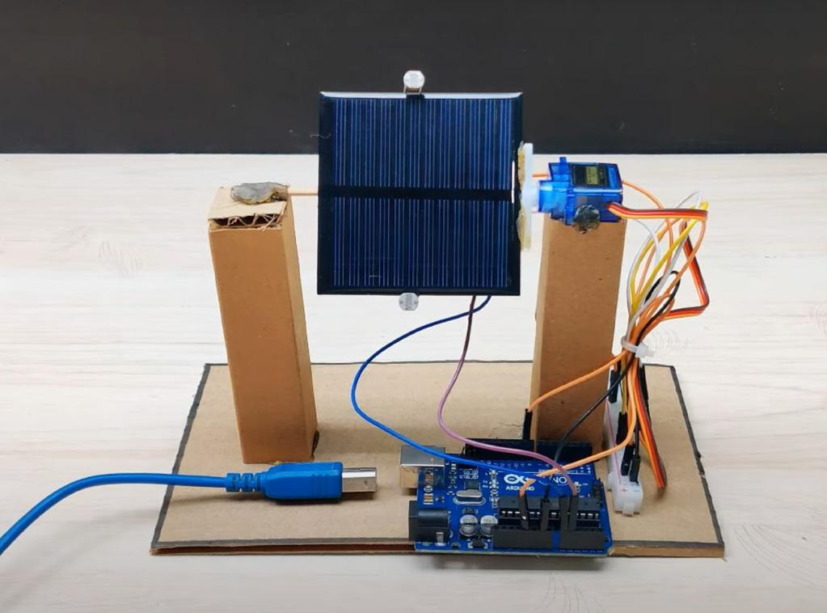
Drawings

Slide 16
Conclusion
The Single-Axis Solar Tracking System improves solar energy generation by automatically adjusting panel angles to follow the sun’s movement. Compared to fixed systems, it boosts energy output by 25-35% while maintaining a balance between performance, cost, and reliability. It requires fewer components and less maintenance than dual-axis systems, making it a cost-effective choice for residential, commercial, and utility-scale solar installations. By integrating solar panels, sensors, motors, and control systems, it ensures optimal sunlight exposure, reducing energy costs and enhancing long-term sustainability in renewable energy production.
.

